Slide 1


WELCOME TO MY PRESENTATION.
COMMUNICATION.
LANGUAGE .
KEVIN JERALD.M

Slide 2
COMMUNICATIN AND LANGUAGE
COMMUNICATION :
COMMUNICATION IS USED FOR EXCHANGING INFORMATION BY SPEAKING OR WRITING .
LANGUAGE :
LANGUAGE IS A MEATHOD OF COMMUNICATION . IN EACH COUNTRY THEY HAVE DIFFERENT LANGUAGES TO COMMUNICATE WITH EACH OTHER …

Slide 3
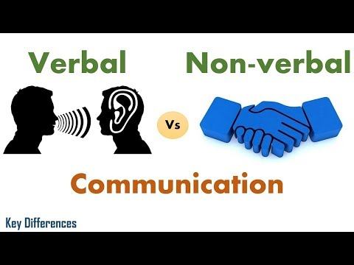
VERBAL AND NON VERBAL COMMUNICATION:

Slide 4


VERBAL COMMUNICATION :
VERBAL COMMUNICATION : INVOLVES THE USE OF WORDS OR SPEECH TO EXPRESS OUR EMOTIONS OR THE INFORMATION TO OTHER PERSON.
INTRAPERSONAL :
OUR THOUGHTS ABOUT THE CONVERSATION.
INTERPERSONAL :
ONE-ON-ONE CONVERATION.
SMALL GROUP CONVERSATION :
CONVERSATION WITH MORE THAN 2 PERSON.
PUBLIC CONVERSATION :
ONE PERSON ADDRESSING A GATHERED NO OF PEOPLE.

Slide 5
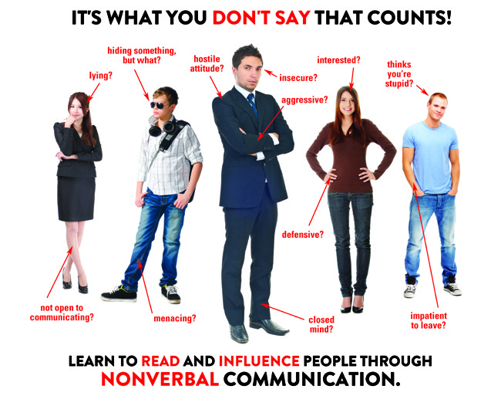
NON VERBAL COMMUNICATION :
NON VERBAL COMMUNICATION IS A COMPLETE PACKAGE OF EXPRESSIONS :
HAND AND EYE MOMENTS .
FACIAL EXPRESSIONS.
POSTURES.
GESTURES.
TOUCH.
ETC…………………

Slide 6

LANGUAGE SKILLS

Slide 7
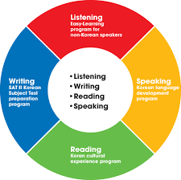
LANGUAGE SKILLS:
LANGUAGE SKILLS IS BASICALLY OF FOUR TYPES :
LISTENING :
SPEAKING :
READING :
WRITING :

Slide 8
THANK YOU! - KEVIN .M

